Slide 1

United Way
Born Learning Academy
Workshop 1

Slide 2
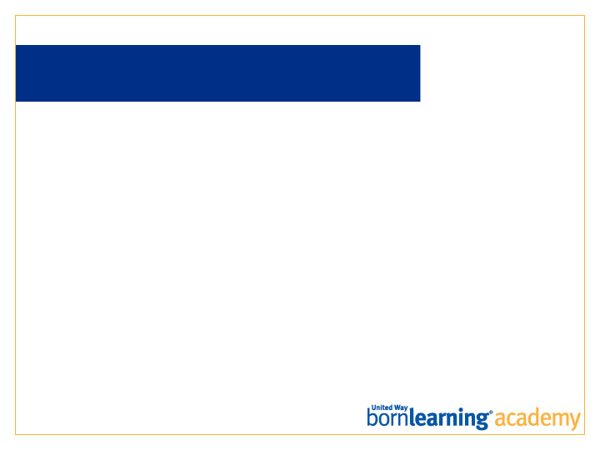
OUR SCHOOL MISSION
Enter mission here.

Slide 3
OUR SCHOOL VISION
Enter vision here.

Slide 4
INTRODUCTIONS
Enter names of staff and support

Slide 5
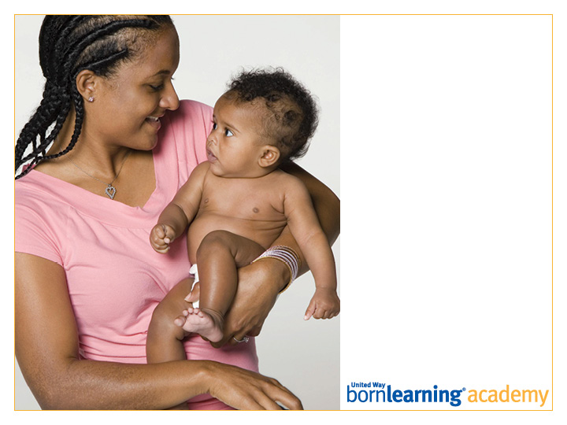
Pre-Test

Slide 6
ICE BREAKER
Introduce yourself.
Choose an item, or items, from the box to share something about yourself with the group.
We will then go around and introduce ourselves using the item you selected from the box.
Notes:
Have numerous everyday items available for participants to choose from. I used items from a junk drawer at my house. Here are some examples: pencil eraser, mirror, rubber band, flower, small lightbulb, outlet cover, key. Ask for volunteers to share with the group.

Slide 7
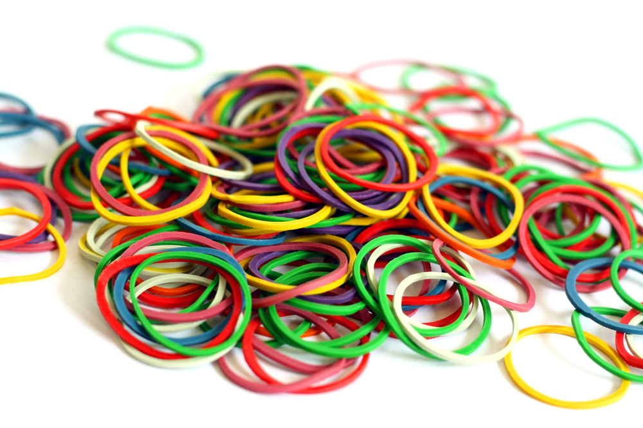
ICE BREAKER
“My name is Donna, and I chose the
rubber band because I want to be flexible,
and learn from this group experience.”

Slide 8
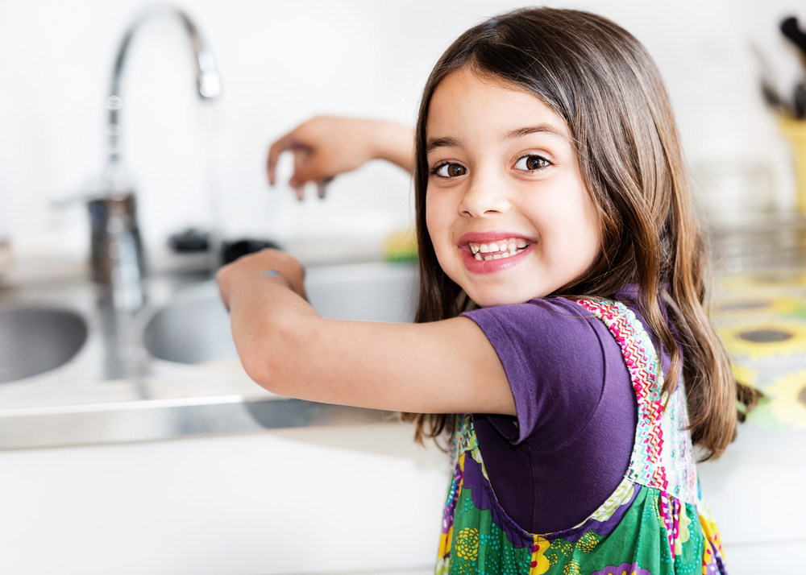
AT THE END OF THIS SESSION, PARTICIPANTS WILL BE ABLE TO:
Understand that children learn from their involvement in all experiences and interactions.
Understand that the best way to help children learn at home is by following their lead.

Slide 9
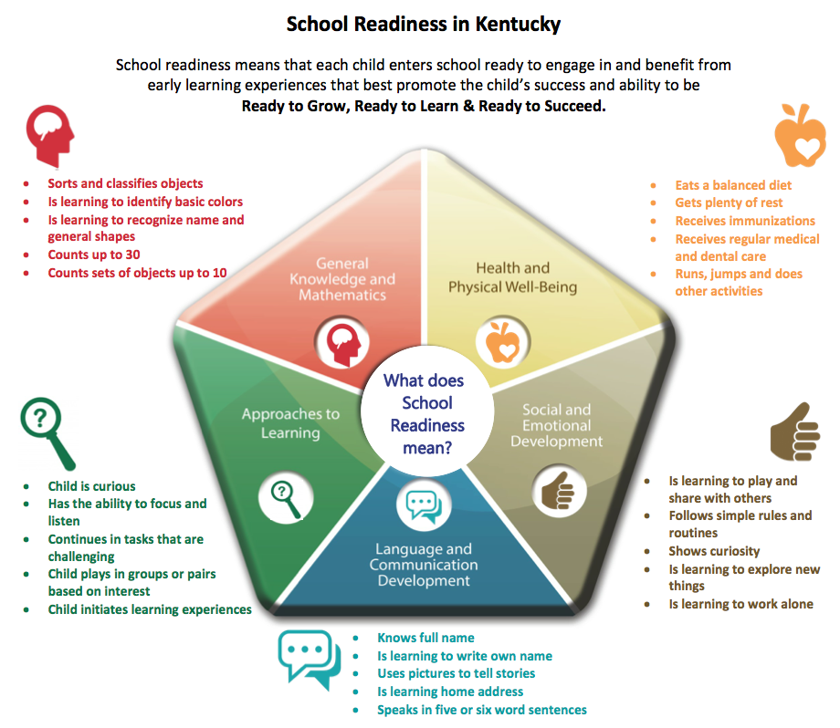
http://kidsnow.ky.gov/School%20Readiness/Pages/default.aspx
Notes:
NOTE: If these points are not applicable in how your state defines school readiness, remove and replace with more appropriate content.
The skills listed in the diagram above are helpful for children to know before entering Kindergarten. The indicators included represent the hopes and aspirations for incoming students, not the expectations. Kentucky recognizes that children develop and learn at different rates and times. Not every child will master all of the skills and behaviors listed above prior to Kindergarten. These skills and behaviors are NOT USED to determine school eligibility. In Kentucky, all children who meet the legal age requirement are entitled to enter public school.
Families, early care and education providers, schools and community partners must work together to provide developmental experiences that promote growth and learning, to ensure that all children enter school eager and excited to learn. The purpose of this definition is to give parents, child care and preschool, and communities an overview of the expectations of schools for incoming students and to help families and communities prepare children for school. In addition, a readiness profile provides teachers, child care providers, and parents a tool to better inform them on the specific strengths and needs of each individual child.
Partners involved in creating this document include the Governor’s Office of Early Childhood, the Kentucky Department of Education, the Governor’s Task Force on Early Childhood Development and Education, the Cabinet for Health and Family Services and the Kentucky Head Start Association. Special thanks to Jefferson County Public Schools for the development of the graphic.
Source: http://kidsnow.ky.gov/School%20Readiness/Pages/default.aspx

Slide 10
WHAT IS EARLY LEARNING?
    Children are born learning and are learning even BEFORE birth.
    Children are active learners.
    Social, emotional and intellectual learning are all connected.
    Learning should be fun!
    Adults need to connect, watch, listen, and extend.

Slide 11
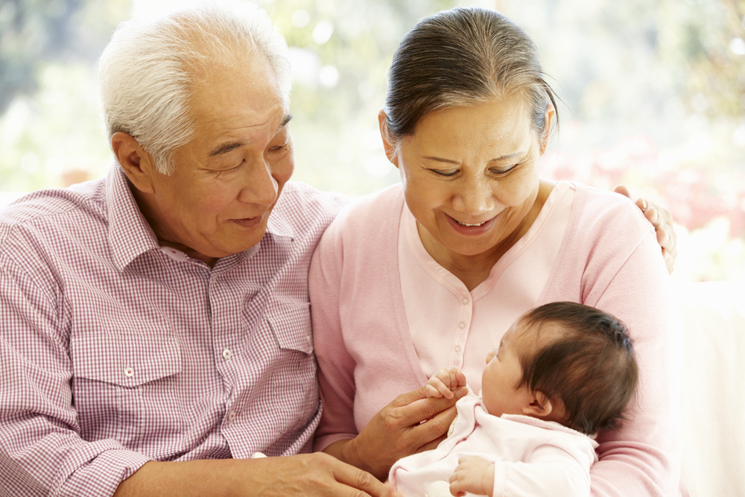
WHAT DOES EARLY LEARNING RESEARCH TELL US?
      Warm, responsive interactions with adults makes a difference in school readiness, resilience and long term success.
      Making a change now can have a huge impact later.
      Children learn by doing.

Slide 12
UNDERSTANDING YOUR
CHILD’S FEELINGS
      Allow them to explore and take risks.
      Follow their lead.
      Introduce one thing at a time.

Slide 13
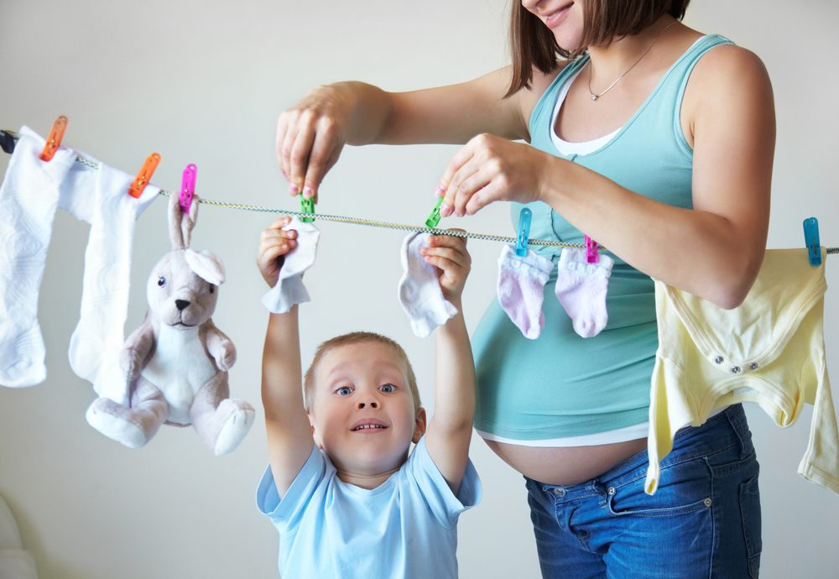
WHEN DO CHILDREN LEARN?
      Every day, all the time.
      They learn all day while we grown ups do the everyday things that need to be done (cooking, laundry, driving, grocery shopping, etc.).

Slide 14
LEARNING DURING
EVERYDAY MOMENTS
https://www.youtube.com/watch?v=_duPYD6kPEA&index=2&list=PL51518A9F2678A602

Slide 15
REMEMBER…
It doesn’t take money... it just takes you!
Turn every day moments into learning opportunities.
There are simple things you can do every day to help children learn and grow.

Slide 16
HOMEWORK
Using things you have around the house, design a musical instrument you and your child can play.
Bring it back to the next session and share with the group.
Various items can be found around the house – coffee cans, metal bowls, wooden spoons, milk jugs, paper towel rolls, rice, oatmeal, popcorn, water bottles with glitter water, water bottle with stuff hidden in sand, etc.

Slide 17
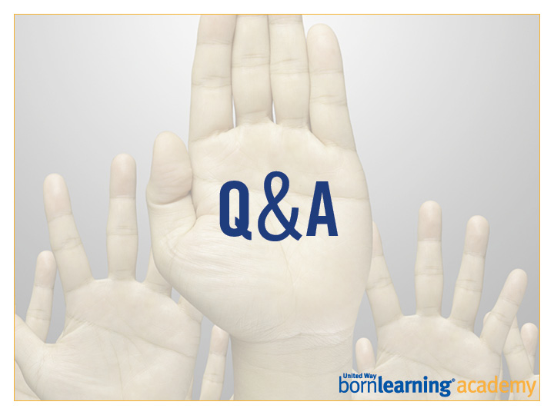

Slide 18
Post-Test

Slide 19
NOW LET’S TRY!
There are 2 different activities for you to experience with your child. Take your time.
Prize at the end.
The KY Parent Guide is a great tool to help your child succeed. Download in the bottom right corner of: http://kidsnow.ky.gov/engaging-families/Pages/Parent-Guides.aspx

Slide 20
ACTIVITY
Pick up your children from __ and break out into groups.
Each breakout meets for __ minutes. Directions will be given there.

Slide 21
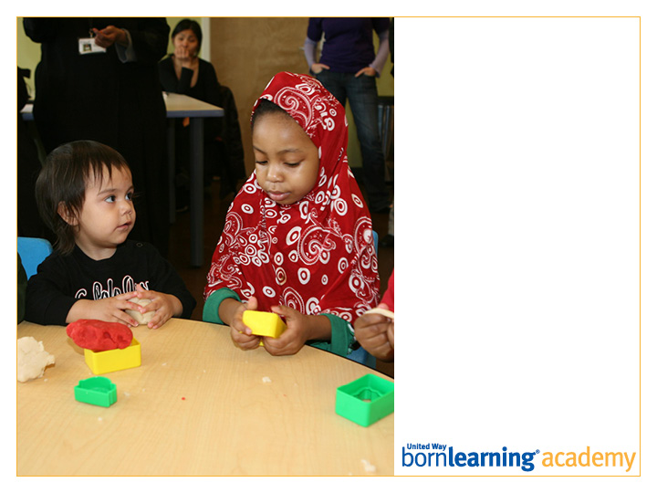
Thank you!
Workshop 2:
DATE AND TIME

Slide 22
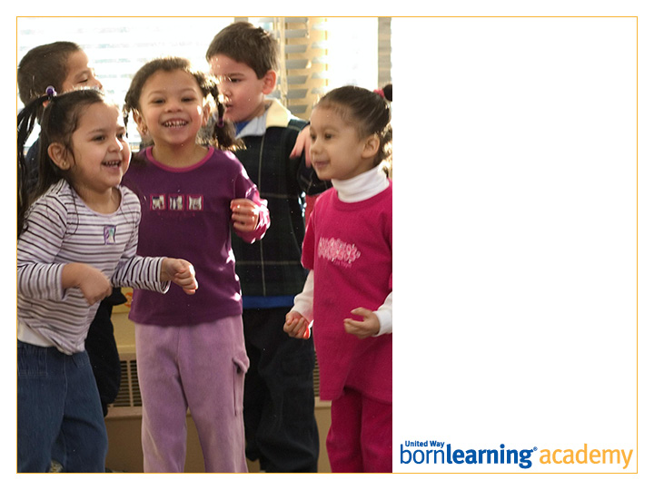
SECTION HEADLINE
Deck style

Slide 23
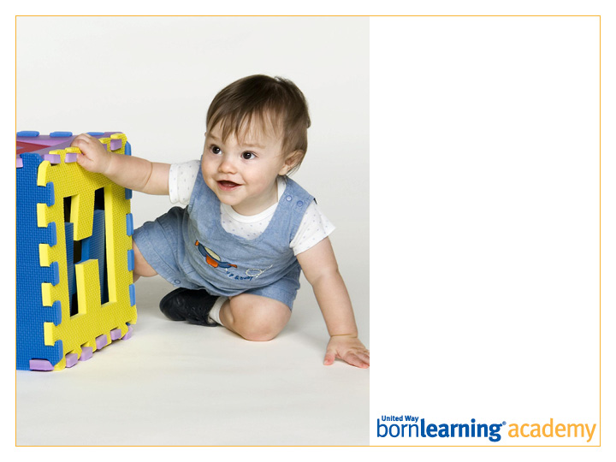
SECTION HEADLINE
Deck style

Slide 24
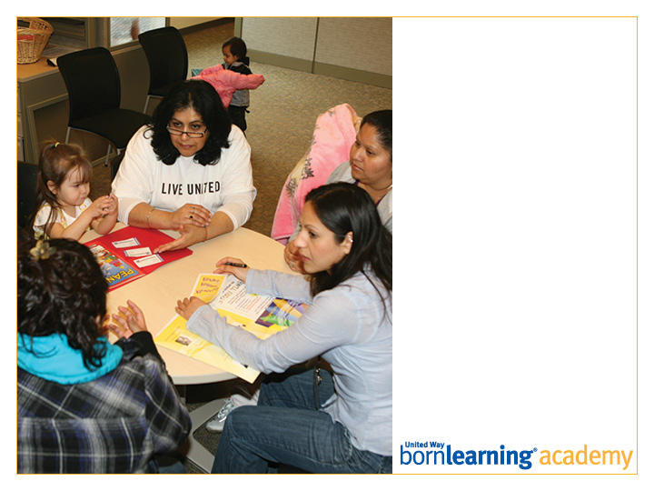
SECTION HEADLINE
Deck style

Slide 25
SAMPLE

Slide 26
SAMPLE
SAMPLE
SAMPLE

Slide 27

SAMPLE

